Slide 1
AAP Healthy Tomorrows 2020 Adolescent Substance Abuse – Screening, brief Intervention and Referral to Treatment
Thursday, October 05, 2017

Slide 2
Adolescent Substance Use and Abuse Why are we here today?
Recreational Use of drugs is an under recognized cause of morbidity and mortality in youth
The underlying use rates remain high despite fluctuating statistics
Adverse Consequences accompany use
An increased risk of dependence among those who began smoking, drinking, and using drugs before age 18.
Most adults with substance Use disorders initiated use during childhood or adolescence

Slide 3
Pediatricians are on the FRONT LINES for
Deterring
Delaying
Detecting
Diminishing
The use of drugs by children
Pediatricians must Understand and Use the tools and strategies effective for these endeavors

Slide 4
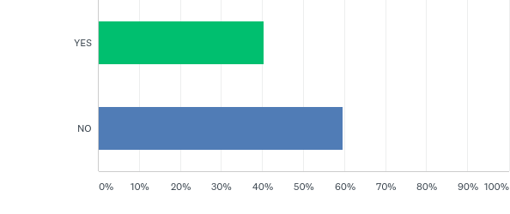
Q1: Are you familiar with SBIRT? ( Screening, Brief Intervention, and Referral to Treatment for Substance Abuse)

Slide 5
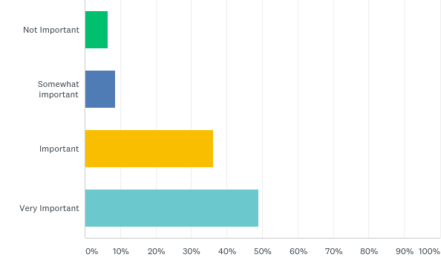
Q2: How important is it for you to develop your clinical skills regarding substance abuse screening, brief intervention and referral to treatment?

Slide 6
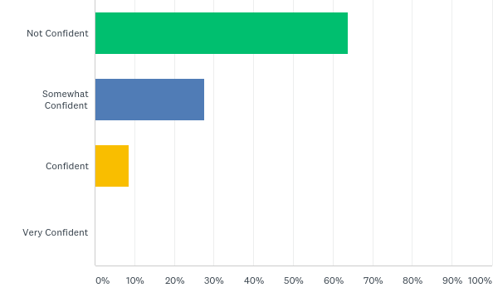
Q3: How confident are you in your current ability to appropriately refer adolescents for addiction medication evaluation and treatment?

Slide 7
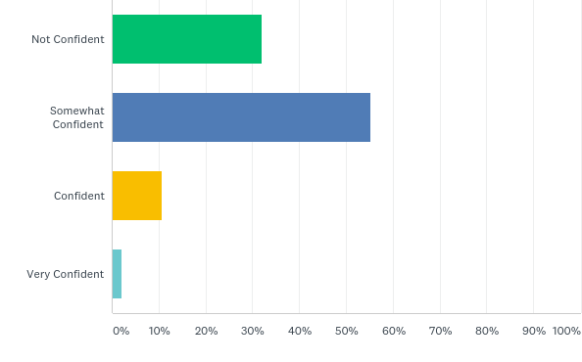
Q4: How confident are you in your current ability to provide brief counseling or guidance with adolescent patients about substance use and abuse disorders?

Slide 8
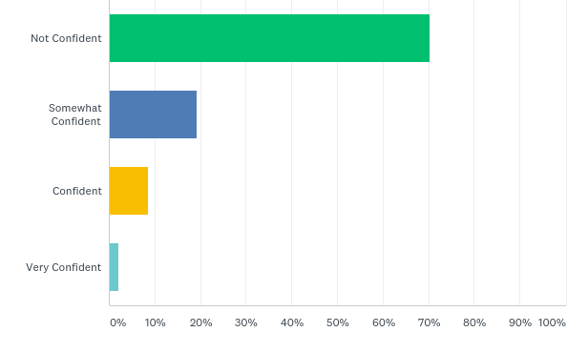
Q5: How confident are you in your current ability to appropriately refer adolescents for addiction medication evaluation and treatment?

Slide 9
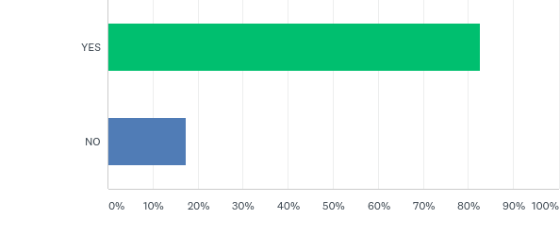
Q6: In your current practice, do you screen for adolescent substance abuse?

Slide 10
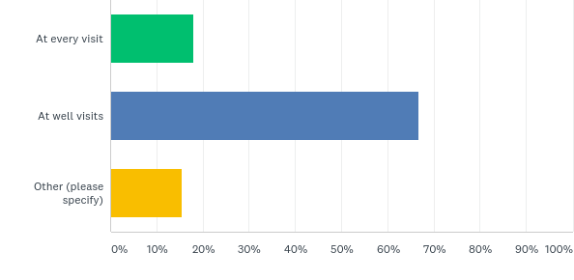
Q7: If question 6 is YES, when do you screen?

Slide 11
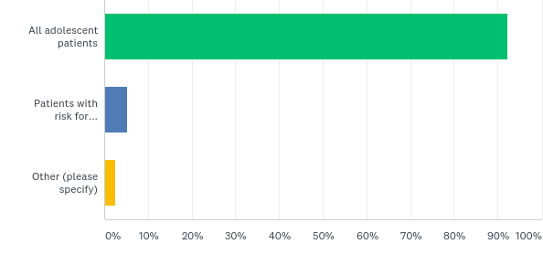
Q8: If question 6 is YES, whom do you screen?

Slide 12
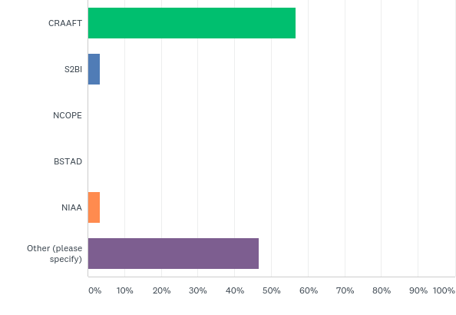
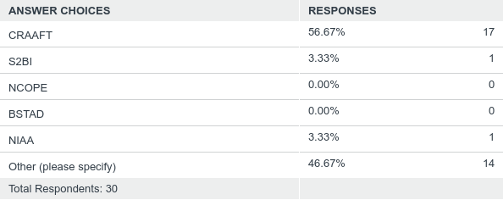
Q9: In your current clinical practice, do you use standardized substance abuse screening tools? (select all that apply)

Slide 13
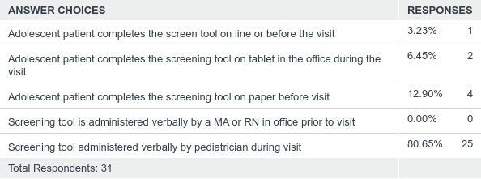
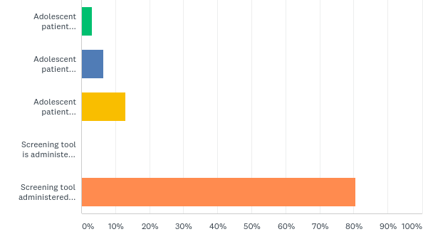
Q10: If you screen in your practice, what methods do you use?

Slide 14
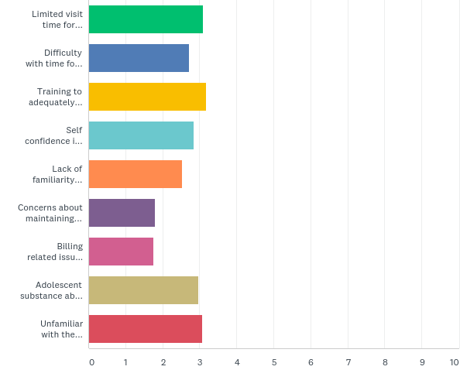
Q11: Rank barriers to substance use screenings in current practice

Slide 15
SBIRT
Identifying and Addressing Unhealthy Substance Use
With Adolescents
Rhode Island College
School of Social Work
RI-SBIRT Resource Center

Slide 16
Introduction
Chris Dorval LCSW, LCDCS, LCDP, ICADC
Project Coordinator- RI SBIRT Training & Resource Center
Treatment Advocate- Recovery Centers or America
Psychotherapist & Consultant- Private Practice
Speakers Bureau- Alkermes

Slide 17
RI-SBIRT Training & Resource Center
Supported by RIC SSW and BHDDH: to build statewide SBIRT awareness and capacity to
implement and integrate SBIRT into diverse settings and organizations,
and promote clinician SBIRT skills and competency.
Notes:
MASBIRT TTA works with a variety of healthcare orgs, to train and prepare sites for SBIRT implementation. including OB GYN depts., primary care sites, ED’s, CHC’s, school nurses, housing sites for elderly, etc.
The MASS Clearing house has many great pt. education materials that you can order for free. Includes the SBIRT toolkit, as well as toolkits for screening adolescents and women of child bearing age.

Slide 18
Selby Conrad, Ph.D.
Assistant Professor, Department of Psychology, Roger Williams University
Clinical Assistant Professor, Department of Psychiatry and Human Behavior, Alpert Medical School of Brown University
Staff Psychologist RIH/HCH and Bradley Hospital

Slide 19
AGENDA
What is SBIRT- Why is it important
Using the CRAAFT
Brief Negotiated Interview
Motivational Interviewing
BREAK/DINNER
Practice Integration Discussion 1
Breakout Simulation with Actors
Practice Integration Discussion 2
Referral to Treatment
Wrap up

Slide 20
Introductions…
Name
Your practice
On a 1-10 scale, how much do you know about SBIRT
What would you like to learn about SBIRT today?

Slide 21
What is SBIRT?
Screening: Identify patients with unhealthy substance use
Brief Intervention: Conversation to motivate patients who screen positive to consider healthier decisions (e.g. cutting back, quitting, or seeking further assessment).
In schools: BI for prevention for all who are screened.
Referral to Treatment: Actively link patients to resources when needed

Slide 22
Unhealthy Substance Use in Clinical Settings
1 in 6 patients talk with their doctor, nurse or other health professional about their drinking¹
1. CDC Vital Signs. National Center for Chronic Disease Prevention and Health Promotion. January 2014.
Notes:
In a January 2014 Centers for Disease Control Vital Signs report, they cited that only 1 in 6 patients talk with a healthcare professional about their drinking. Which leaves 5 out of every 6 patients NOT talking about their drinking with a healthcare provider.
This creates an elephant in the room in which alcohol use isn’t being talked, which isn’t great.
Goal→ acknowledge the elephant in the room and create the opportunity to have a meaningful conversation about it.
SBIRT really removes the elephant by talking and asking EVERYONE about substance use, and then providing further assessment and guidance as needed.
22

Slide 23
Addiction: Historical Perspective
Problem
No Problem
Notes:
10/12/17
23

Slide 24
What is addiction anyway?
Short Definition of Addiction: (American Society of Addiction Medicine, 2011)
Addiction is a primary, chronic disease of brain reward, motivation, memory and related circuitry. Dysfunction in these circuits leads to characteristic biological, psychological, social and spiritual manifestations. This is reflected in an individual pathologically pursuing reward and/or relief by substance use and other behaviors.

Slide 25
Addiction continued….
Addiction is characterized by inability to consistently abstain, impairment in behavioral control, craving, diminished recognition of significant problems with one’s behaviors and interpersonal relationships, and a dysfunctional emotional response.
Like other chronic diseases, addiction often involves cycles of relapse and remission. Without treatment or engagement in recovery activities, addiction is progressive and can result in disability or premature death.

Slide 26
Paradigm Shift: Chronic Disease
Unhealthy
Alcohol and
Drug Use
Disease
Pre-Disease/
Higher Risk
Low / No Risk
Notes:
Alcohol binging (NIAAA)
Men (<65) more than 4 drinks/day
Women (& anyone >65) more than 3 drinks/day
Any illicit drug use
Any prescription drug misuse (taking more than prescribed or for ‘non-medical reasons’)
10/12/17
26

Slide 27
Why SBIRT For Youth?
Reduces substance use related harm during adolescence
Provides education and intervention for both primary and secondary prevention to keep all patients healthy
Provides early identification of risky behaviors to assist providers with treatment planning
Identifies need for referral to prevent harm at the
earliest possible stages among patients

Slide 28
What’s a Drink?

Slide 29
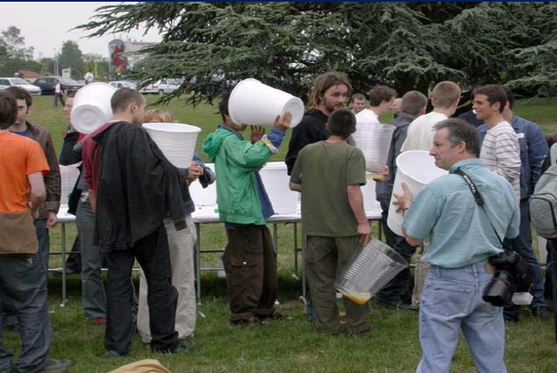

Slide 30
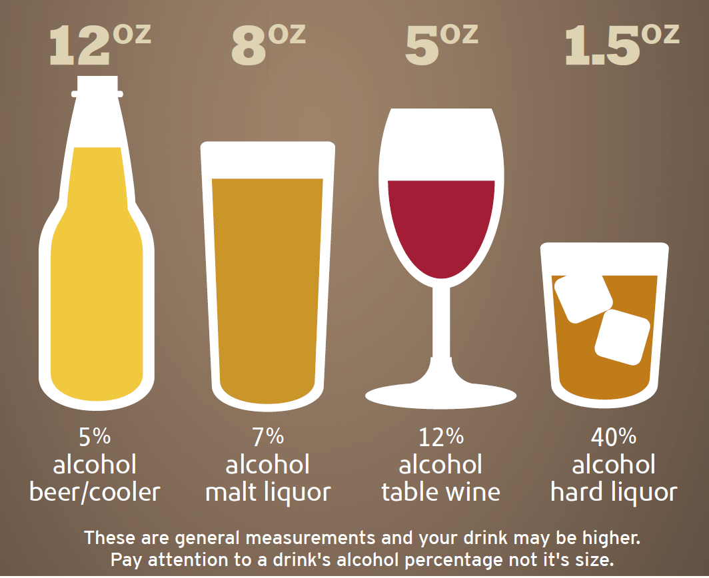
What is a ‘standard’ drink?
Refs: National Institutes of Health, NIAAA. http://rethinkingdrinking.niaaa.nih.gov/whatcountsdrink/whatsastandarddrink.asp;
Adapted from SBIRT Montana Poster: www.dphhs.mt.us
Drinking Guidelines Explained: http://ireta.org/2013/09/30/low-risk-drinking-guidelines-where-do-the-numbers-come-from/
Notes:
30
These are some examples of what constitutes a standard drink.
12 oz of 5% alcohol/wine cooler
8 oz or 7% malt liquor
5 oz of wine
1.5oz of alcohol hard liquor
It’s also important to think about how many drinks may be in something you order at a restaurant (martini, etc.).
These guidelines were established from a bunch of epidemiological data to help develop a sense of where increased risks may begin.
The IRETA link at the bottom has a really great explanation of the some the alcohol guidelines a bit more…
Drinking above these guidelines simply increases your risk and SBIRT wants to help patients understand and be aware of these risks.

Slide 31
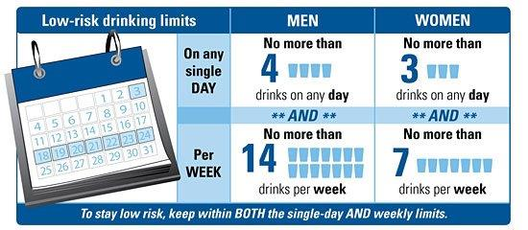
Maximum Drinking Limits For People Over 21
Non-Pregnant Women
Pregnant Women are advised to abstain from alcohol use
People with medical conditions and people on medications should speak with their
doctor about alcohol use.
People under 21 should not drink at all.

Slide 32
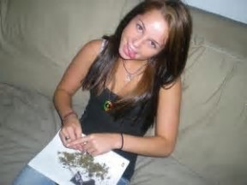
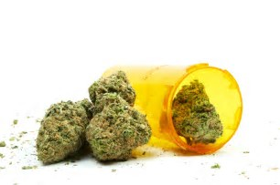
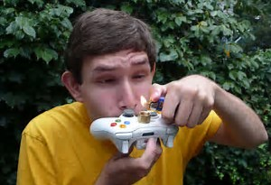
What about marijuana?

Slide 33
Marijuana Use
Marijuana can be addictive
According to The National Institute on Drug Abuse (NIDA) 9% of marijuana users will become addicted to it…roughly 1 in 11
That number increases to 17% for those who start using before age 16… roughly 1 in 6
Among daily marijuana 25-50 % become addicted.

Slide 34
Cannabinoid System
Delta-9-tetrahydrocannabinol or THC accounts for most of marijuana's psychoactive, or mind-altering, effects.
THC is non-water soluble. THC is fat soluble. THC loves fat.
It stores in the fat cells of the body, the brain, the liver, the kidneys, in other words - the major organs
The half- life of THC for an infrequent user is 1.3 days and for frequent users 5-13 days (Smith-Kielland, Skuterud, & Morland, 1999)

Slide 35
Other substances
Opioids
Oxycodone, hydrocodone, hydromorphone, buprenorphine, fentanyl
Benzodiazipines
lorazepam, clonazepam, oxazepam, alprazolam
Stimulants
Adderall, Ritalin, MDMA, cocaine

Slide 36
SBIRT Goals
Addiction:
Treat and/or refer for specialty addiction treatment
Risky Use:
Educate to decrease risk of negative health & safety consequences and progression of disease
Low/No Risk:
Educate about risks and reinforce/ promote healthy norms
Notes:
The goals of SBIRT are to screen everyone and provide appropriate feedback whenever someone is falling on the spectrum.
One of SBIRT’s main focuses is to identify low/no risk individuals and continue to provide education about the risks associated with alcohol or other behaviors. Additionally, promoting the health norms and affirming the choices these individuals are making.
Risky use is another opportunity for SBIRT to provide education about alcohol or other substances, including negative health and safety consequences, in an effort to prevent the progression of the disease.
Individuals with addiction (substance use disorders) may need treatment or specialty treatment.
36

Slide 37
The SBIRT Model : A Continuum of Substance Use
Social Use
Abstinence
Abuse
Experimental Use
Binge Use
Substance Use Disorder
Notes:
This is an animated slide. Click to start the animation sequence.
This is a visual representation of the broader continuum recognized by SBIRT which accounts for various use patterns and adds yellow light people.

Slide 38
What is the prevalence of unhealthy substance use?

Slide 39
Teens and Substance Use; Some Good News
Most students go through school & don’t ever use drugs or get drunk.
The Monitoring the Future (MTF) survey found that
53.3% never used any illegal drug
58% never smoked marijuana.

Slide 40
Adolescent Substance Use vs. Adults
Notes:
SAMSHA 2014

Slide 41
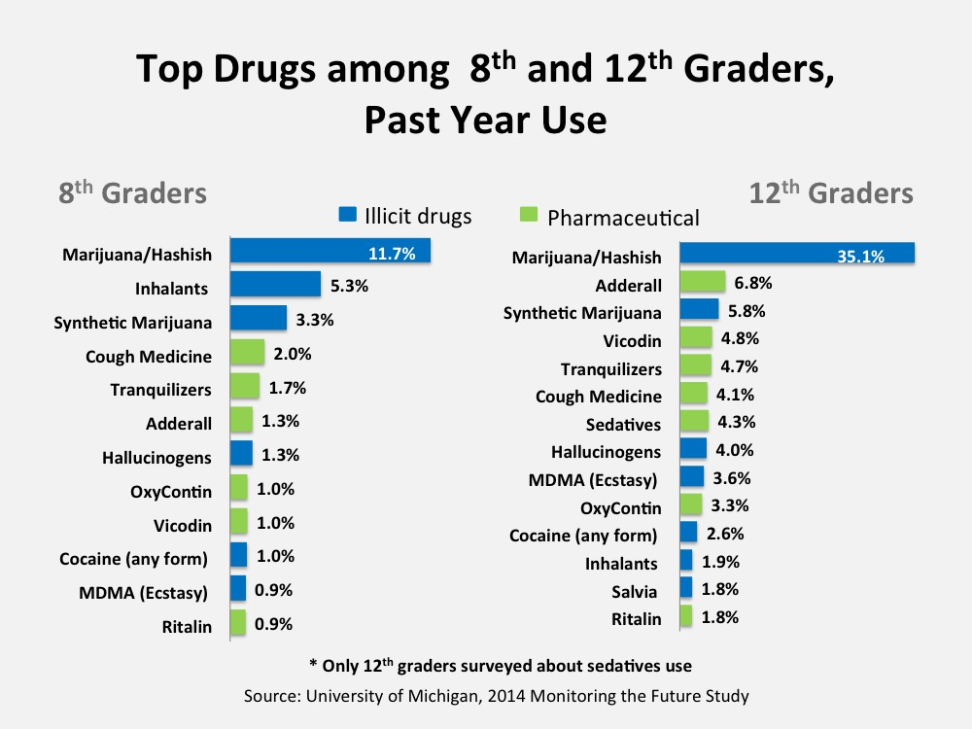
Notes:
Drugs
Pain killers (Vicodin, Hydrocodone, Percocet, Oxycontin)
ADHD stimulant medication (Adderall, Ritalin)
Anti-anxiety (tranqualizers)—benzo’s (Xanax, Valium, Klonodin
Sedatives (barbituates)—may be overestimate because kids include non-prescription sleep aids
Inhalants--glue, nail polish remover, gasoline, solvents, butane, and propellants used in certain commercial products such as whipped cream dispenser
Cough medicine-dextromethorphan
Salvia—legal, smoked, bought at “head shops”, can produce powerful hallucinations
NOT ON LIST
Heroin—SINCE THE LATE 90s heroin use has been on the decline among high school students (e.g., from 2014 to 2015) decline from .6% to .5% of 12th graders
Meth- very low (less than 1%)
Heroin Epidemic
Between 2002 and 2013, the rate of heroin-related overdose deaths nearly quadrupled, and more than 8,200 people died in 2013
Heroin use more than doubled among young adults ages 18–25 in the past decade.

Slide 42
Substance Use in New England Teens

Slide 43
RI Youth Substance Use Data

Slide 44
Prevalence of Lifetime DX of SUD by Age of Onset of Drinking:
It’s Bad To Start Drinking Early
<13 14 15 16 17 18 19 20 21+
©2007 Center for Adolescent
Substance Abuse Research,
Children’s Hospital Boston. All rights reserved.
Source: Hingson et al., 2006
Notes:
This study conducted by Hingson and colleagues surveyed over 43,000 adults (from a national survey, NESARC). Of those adults, they used diagnosistic criteria to categorize who met criteria for alcohol dependence (based on DSM-IV criteria).
Of those adults who met criteria for alcohol dependence, they completed a retrospective analysis to see at what age they began drinking. “Respondents were asked the age at which they first started drinking, not counting tastes or sips, which was categorized as younger than 14 years, separately for each year from 14 through 20 years old, and 21 years and older (the minimum legal drinking age in the United States.
They found a strong relationship with the age in which the individual began drinking and the percentage of lifetime dependence.
47% of individuals who began drinking at age 13 or younger had a diagnosis of alcohol dependence at adulthood.
Only 9% of individuals who began drinking at age 21 or older developed alcohol dependence.
Researchers concluded that:
Nearly half (46%)of drinkers who developed alcohol dependence began drinking at 16 years or younger, although only one quarter of drinkers started by that age.
First, the younger the age at which people started to drink, the greater their likelihood of developing alcohol dependence within 10 years of drinking onset and before age 25 years.
One risk that we think about particularly in regard to adolescents is brain development. We are continuing to understand how the brain matures and developed, and we now know that brain development continues on until early adulthood (mid-20s). Lots of brain connections are continuing to develop and solidify during adolescence and substance use (i.e., marijuana use) may interrupt important parts of brain development.

Slide 45
Why is SBIRT important?

Slide 46
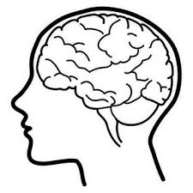
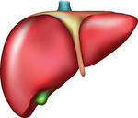
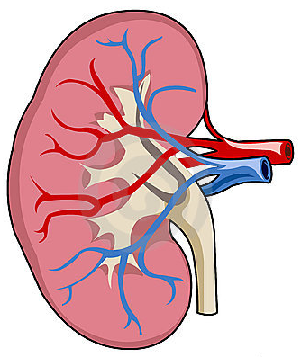
Health Consequences of Substance Use
Fetal Alcohol Spectrum Disorders
Hypertension
Cardiovascular disease
Stroke
Cardiomyopathy
Arryrithmias
Cancer
Breast
Throat
Mouth
Esophagus
Liver
Diabetes mellitus
Osteoporosis
Liver disease
Fibrosis
Cirrhosis
Alcoholic hepatitis
HIV/AIDS
Renal disease
Pancreatitis
Hepatitis C
Overdose
Accidents/Injury
Depression
Source: UpToDate 2015 Mukamal KJ. Overview of the risks and benefits of alcohol consumption .
Up To Date 2015. Weaver MF, Jarvis MAE. Substance use disorder: Principles for recognition and assessment in general medical care.
http://pubs.niaaa.nih.gov/publications/Hangovers/beyondHangovers.pdf
Notes:
Depending on a patient’s use/severity/ family hx/previous medical history, etc. SU can lead to a variety of health consequences from hypertension to overdose, etc.
SBIRT provides an opportunity for providers to take proactive measures with patients who may be engaged in risky use of substances, but are not currently seeking or in need of specialty treatment.
Substance use can exacerbate or impact other medical conditions. Depression for example, is something for which alcohol may serve a purpose to “self-mediate” or help an individual control the symptoms that they don’t want to sit with.
From Lasser et al:
Women with unhealthy substance use are less likely to receive mammograms than women without unhealthy substance use.
Persons with unhealthy substance use are less likely to receive flu vaccination than persons without unhealthy substance use.
Unhealthy substance use is not a risk factor for not receiving cervical or colorectal cancer screening.

Slide 47
Why Screen Everybody?

Slide 48
Introducing Screening to Patients
Screening is universal
Contributes to quality healthcare
Confidential as part of your medical / school record
Ask permission to screen: Think MI (Motivational Interviewing)!

Slide 49
Pre-Screen Questions: Middle School
Do you have any friends who drank beer, wine or any drink containing alcohol in the past year?
How about you ? – in the past year how many days have you had more than a few sips of beer, wine or any drink containing alcohol in the past year?
What about other substances? Do you have any friends who use tobacco, marijuana, inhalants, prescription drugs that were not prescribed to them or anything else to get high?
How about you ? – in the past year how many days have you used tobacco, marijuana, inhalants, prescription drugs that were not prescribed to them or anything else to get high?

Slide 50
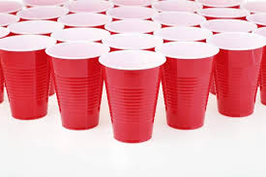
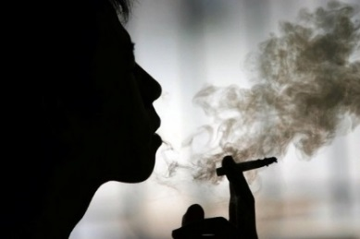
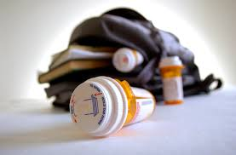
Pre-Screen Questions: High School
How many times in the past year did you…
Drink any alcohol?
Smoke any marijuana?
Use anything else to get high?
(“Anything else” includes illegal drugs, over the counter and prescription drugs, and things that you sniff or “huff”.)
If all answers are “No”, ask CAR question; then stop
Source: http://www.ceasar-boston.org/clinicians/crafft.php

Slide 51
C R A F F T
During the PAST 12 MONTHS,
Have you ever ridden in a CAR driven by someone (including yourself) who was “high” or had been using alcohol or drugs? No Yes
Do you ever use alcohol or drugs to RELAX, feel better about yourself, or fit in? No Yes
3. Do you ever use alcohol or drugs while you are by yourself, or ALONE? No Yes
4. Do you ever FORGET things you did while using alcohol or drugs? No Yes
5. Do your FAMILY or FRIENDS ever tell you that you should cut down on your drinking or drug use? No Yes
6. Have you ever gotten into TROUBLE while you were using alcohol or drugs? No Yes

Slide 52
CRAFFT Scoring
Each “yes” = 1 point
A total score of 2+ is a positive screen and indicates a need for additional assessment (brief intervention)
Source: http://www.ceasar-boston.org/clinicians/crafft.php

Slide 53
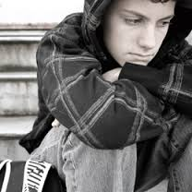
Brief Negotiated Interview
Open Question?
Ruler?
Action Plan?
Affirmation?
Reflection?
Summary?
Pros/Cons?
Minimize
Push Back?
Feedback?
?
An evidence-based algorithm that provides a structured format for using motivational interviewing skills in the context of clinical care

Slide 54
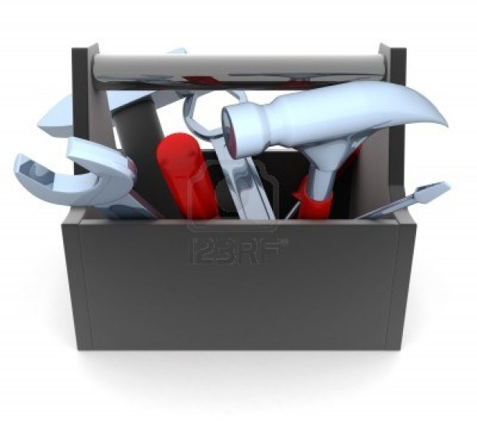
Brief Negotiated Interview (BNI)
Five Steps:
Build Rapport/Engagement
Pros and Cons
Feedback
Readiness Ruler
Action Plan
Developed by BNI-ART Institute,@ BU.edu and The Yale Brief Negotiated Interview Manual. D’Onofrio, et al. New Haven CT: Yale Univ. School of Med. 2005

Slide 55
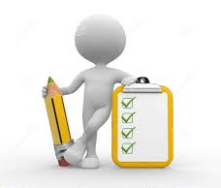
Things to Note about the BNI
Follows a scripted approach
BNI is the skeleton, but you bring it to life!
Not always linear; might need to adapt process as situation unfolds
While ideal, it might not be possible to complete each step at every encounter

Slide 56
Giving Feedback & Advice: The MI Sandwich
Ask Permission
“Is it OK if I share with you what is considered high risk drinking according to research studies?”
Give Information or Feedback
Ask for Response
“What do you make of that?”

Slide 57
BI: Education & Information; Lower Risk
Giving Feedback & Advice
Determine the patient’s perception of his/her need to change and perceived ability to change
“How do you see your drug use?”
Gauge the patient’s reaction to the information
“What do you think about this information?”
Assess the patient’s stage of readiness to change behavior
“On a scale from 0 to 10, how important is it for you to change?… Why not a lower number?”
Samet, JH, Arch Intern Med 1996

Slide 58
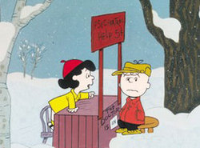
Brief Negotiated Interview (BNI)
Patient Voice and Choice
Guiding, not directing
Avoid the “righting reflex”
Patient as decision maker
They’re in the driver’s seat

Slide 59
Step 1: Build Rapport/Engagement
Before we start, I’d like to know more about you. Would you mind telling me a little bit about yourself?
What is a typical day like for you?
How does your [x] use fit in?

Slide 60
Step 2: Pros and Cons
Explore PROS and CONS
Use reflective listening
Summarize
I’d like to understand more about your [X] use.
What do you enjoy about [X]? What else?
What do you enjoy less or regret about your [X] use? What else?
If NO cons: Explore problems mentioned in screening.
“You mentioned … Can you tell me more about that situation?”
So, on the one hand you said [PROS], and on the other hand you said [CONS].

Slide 61
Step 3: Feedback
Ask permission
Provide information
Elicit response
What do you know about the health effects and/or risks of [X]?
Would you mind if I shared some additional information with you?
Provide 1-2 salient substance specific health effects/risks.
What are your thoughts on that?

Slide 62
Step 4: Readiness Ruler
1 2 3 4 5 6 7 8 9 10
Readiness ruler
Envisioning change
To help me understand how you feel about making a change in your [X] use, [show readiness ruler]…
On a scale of 1-10, how ready are you to change any aspect related to your [X] use?
Why did you choose a [X] and not a lower number like a 1 or 2?
If they choose “0”: What would need to happen in your life to consider making a change?

Slide 63
Step 5: Action Plan
Develop plan
Assess confidence
Explore challenges
Summarize
Thank client
What are you willing to do for now to be safe and healthy?...What else?
On a scale of 1-10, how confident (1-10) are you that you could do that?
Why did you choose a [X] and not a lower number like a 1 or 2?
What are some challenges to reaching your goal?
Let me summarize what we’ve been discussing, and you let me know if there’s anything you want to add…[review action plan]
Thanks for being so open with me today!

Slide 64
Confidence Scale
Assesses patient’s confidence
Identifies potential barriers
“What would you need to change for you to feel more confident?”
Can discuss previous successes to build confidence
“What changes have you made in your life?”
“How did you accomplish that change?”

Slide 65
SBIRT BNI Steps
Ask single item question
Assessment if needed (AUDIT, CAGE, etc…)
Ask for permission to provide information
Reflect on their reaction to the information you provide them
Use positive affirmation
Ask if they are ready to make a change ->If so gauge with Readiness Ruler.
Once answer is given ask “Why not (lower number)….?
Reflect on their response
Summarize the interview-> “Do you have any other questions? Did I miss anything?
Make referral if necessary

Slide 66
Motivational Interviewing (MI): A Review
Patient-centered
Goal-directed (behavior change)
Helps to resolve ambivalence
A-C-E
Affirms patient’s autonomy
Collaboration between patient and provider
Evokes patient’s own motivation and reasons for change

Slide 67
Key MI Communication Skills: O.A.R.S.
Open Questions
Affirmations
Reflections
Summaries

Slide 68
Change Talk
Statements about change
Linked to a specific behavior
Typically comes from patient
Phrased in the present tense
Desire
Reasons
Need
Commitment
Steps
Ability
I want to…
I could or might be able to…
Things would be better if I …
I really should…
I am ready to…
This week I started…
Source: Rosengren, 2009.

Slide 69
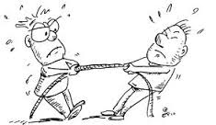
What is Pushback?
Absence of collaboration between two people
Normal part of adolescence and change process
Product of interpersonal dynamics
Cue to try something different (reflections)
Less resistance → more likely to change
GOAL: Not to eliminate pushback, but to minimize it.

Slide 70
Tips to Decrease Patient Pushback
Don’t try to convince them that they have a problem.
Don’t argue about the benefits of change.
Don’t tell them how they should change.
Don’t warn them of the consequences of not changing.

Slide 71
Practice Integration Discussion 1
Who does the screening?
How is it administered?

Slide 72
BNI in Action
Breakout into groups to practice BNI

Slide 73
Practice Integration Discussion 2
Co-occurring mental health

Slide 74
Co-occurring Disorders
Of individuals with a MH disorder:
1/3 will experience unhealthy substance use at some point¹
Of those with severe mental illness:
50% will develop a substance use disorder ²⁻⁵
Of women with unhealthy substance use:
As many as 2/3 of women may have a MH disorder ⁶
Adapted from: IHR Co-Occurrence of MH with Physical & Sexual Abuse Fact Sheet.
Sacks S et al. Substance Use & Misuse 1997. 2. Drake RE et al. Psych Rehab Jour 2004. 3. Barry KL et al. Schizophrenia Bull 1995. 4. Kessler RC et al. Arch Gen Psych 1997. 5. Mueser KT et al. Acta Psychiatrica Scandinavica 1992. 6. Alexander, M.J. American Journal of Orthopsychiatry 1996.
Notes:
MH disorders and unhealthy substance use go hand and hand
Some other research shows that:
Of individuals who have a MH disorder, 1/3 of them also experience unhealthy substance use at some point.
Relatively speaking that’s 2X the rate of individuals that experience unhealthy substance use in comparison with individuals without a MH diagnosis.

Slide 75
Co-occurring disorders in Adolescents
Adolescents with SED (serious emotional disturbance) are five times more likely to have an alcohol dependence problem than those without SED
43% of youth receiving mental health (MH) treatment services have a COD
90% with COD had one mental disorder prior to the onset of an SUD
Rates of COD are approximately 50% for adolescents diagnosed with either a mental health disorder or SUD
Notes:
1. Substance Abuse and Mental Health Services Administration. (2002). Report to Congress on the Prevention and Treatment of Co-Occurring Substance Abuse and Mental Health Disorder. 2. SAMHSA. (2014). The NSDUH Report. Retrieved from http://www.samhsa.gov/data/NSDUH/2013SummNatFindDetTables/NationalFindings/NSDUHresults2013.pdf 3. Sheidow, A. J., McCart, M., Zajac, K., & Davis, M. (2012). Prevalence and Impact of Substance Use Among Emerging Adults with Serious Mental Health Conditions. Psychiatric Rehabilitation Journal, 35(3), p. 235-243.

Slide 76
Mood/Anxiety/ ADHD Disorders
More than 1 in 5 children/adolescents have a diagnosable mental health disorder
Approximately 2.6 million (10%) of adolescents have experienced a Major Depressive Episode in the past year
About 21% of children 9-17yo have mental
health or substance use disorder with at least
minimum impairment

Slide 77
Truven Rhode Island Behavioral Health Report
Children and adolescents aged 5–17 years in Rhode Island had higher rates of attention deficit hyperactivity disorder than most other New England states and national averages.
Adolescents aged 12 – 17 were more likely to have major depressive episodes than other New England states and the national average
In addition, one in five (19.0%) children ages six to 17 has a diagnosable mental health problem
One in ten (9.8%) has significant functional impairment (Kids Count Factbook, 2015).
Roughly 8,000 adolescents (9.9 % of all adolescents) per year in 2009-2013 had at least one Major Depressive Episode (MDE) within the year prior.
This percentage has increased significantly since the 2009-2010 survey of 8.1%.

Slide 78
Definition of Trauma
Trauma occurs when an external threat overwhelms a person’s internal and external positive coping skills.
Notes:
Discuss this definition and the nuances of what can be traumatic for an individual may or may not for another. Stress how addiction can be a coping skill and by removing substances we are placing our men at risk without POSITIVE coping skills.

Slide 79
Trauma and ACE scores in IV drug use
If a child has six or more “yes” answers, their risk of becoming an IV drug user increases by 4,600% compared to a child with a score of zero.
(Felitti & Anda, 2010)

Slide 80
"Psychologically maltreated youth exhibited equivalent or greater baseline levels of behavioral problems, symptoms, and disorders compared with physically or sexually abused youth on most indicators."
(Spinnazola et. al 2014)

Slide 81
Drug testing for Adolescent Substance Use
Often used as part of an assessment for substance use
Indications for and how to use not clear
Complexity of the procedure and limitations of the information limit utility

Slide 82
Indications for VOLUNTARY Drug Testing in Primary Care
As part of an assessment of Behavioral or Mental Health Symptoms suggestive of drug use or abuse and is not volunteered in a thorough history
For substance abuse management plans that use contingency management strategies ( reward based therapy or juvenile justice drug use deterrent strategy or parent engaged strategy
Home Drug Testing…efficacy unknown
“medical clearance” to return to school…not necessarily a drug test ( a negative test might be the most helpful to support history)
Notes:
Nonspecific signs and symptoms that may signify substance use or abuse
General screening not encouraged. Limited efficacy and potential for unintended effects

Slide 83
Sources of error in Interpreting Urine Drug test…..A complex process
False Positive results (cross reactivity e.g. Fluoroquinolone and opiates)
Can’t distinguish appropriate use from misuse of prescribed medications (ADHD medications and amphetamines
False Negative results
urine tampering by dilution or ingestion of substance to elevate urine creatine
Masking urine with an agent that interferes with immunoassay,
timing of drug use,
abused substance or metabolites not detected on drug panel
Notes:
Drug detection in the absence of illicit drug use
Failure to detect illicit substance that is abused
Maskin substances ( commercial, bleach, ammonia, soaps)

Slide 84
Urine drug testing for substances of abuse…. Some substances are not detectable in routine drug testing
Drug | Initial testing drug cutoff concentration (ng/ml) | Analytes tested | Confirmation Cutoff Concentration ng/ml | Urine Detection Time (days)
Amphetamine | 1000 | Amphetamine (NOT methylphenidate) | 500 | 2-4
Barbiturates | 200 | Amobarbital, secobarbital, other barbiturates | 200 | 2-4 for short acting, up to 30 for long acting
Benzodiazepines | 200 | Oxazepam, diazepam, others (NOT Clonazepam) | 200 | Up to 30 for long acting
Cocaine | 300 | benzoylecgonine | 150 | 1-3 for sporadic use, up to 12 for chronic use
Codeine | 300 | Codeine, morphine | 300 | 1-3
Heroin | 300 | Morphine, 6-acetylmorphine | 300,10 | 1-3
Marijuana | 100,50,20 | Tetra-hydrocannabinol (THC) (NOT Synthetics) | 15 | 1-3 for causal use, 4-6 moderate use, up to 30 for chronic use
Methadone | 300 | methadone | 300 | 2-4
Methamphetamine | 1000 | Metamphetamine, amphetamine | 500, 200 | 2-4
Phencyclidine | 25 | phencyclidine | 25 | 2-7 for casual use up to 30 for chronic use
Notes:
MOST common form of screening by pediatricians, often in office.
A Know the TYPE of urine drug test being used….
qualitative (POCT and home drug) , east to perform, use enzyme linked immunoassays (EMIT) and give instant positive negative results, sensitive, but susceptible to cross reactivity, resulting in false positives so less specific…requiring confirmatory tests of positive results in laboratories
Quantative ( lab testing) usually GC_MS
B. Know the scope of the drugs being tested ( many prescription drugs not detectable or not in time window of detection)
C. Time frame of what you are testing for before choosing a test ( acute or current use)
D. Tests should only be performed in CLIA certified labs
E. Urine tests are highly susceptible to tampering

Slide 85
If Testing for Substances Develop a protocol for office testing in collaboration with substance abuse providers
Develop a practice plan for voluntary and for confidential screening and explanation of procedures
Don’t test unless patient consents. Discuss how to handle results
Know the laws protecting adolescent confidentiality, its limits and the guidelines for medical judgment
Obtain consent to share with substance abuse provider
Develop Procedures for how to urine test to improve sample quality
Direct observation or label if not observed
Separate bathroom, no sink or soap, tint the toilet water
Measure urine temperature, document appearance and specific gravity
Consider ordering urine creatine to validate SG

Slide 86
Referral to Treatment
Resources
Level of care
Psychopharmacology
Working with BH providers

Slide 87
RI-SBIRT Resource Center Contact Information
Chris Dorval- Project Coordinator
401-626-0169
cdonovandorval@ric.edu
www.risbirt.org

