Slide 1
Infection Prevention Across Community Settings: A Focus on Medical Offices, Schools, and Extracurriculars

Slide 2
Disclosures:
We have no relevant financial relationships with the manufacturer(s) of any commercial product(s) and/or provider of commercial services discussed in this CME activity
We do not intend to discuss an unapproved/investigative use of a commercial product/device in our presentation

Slide 3
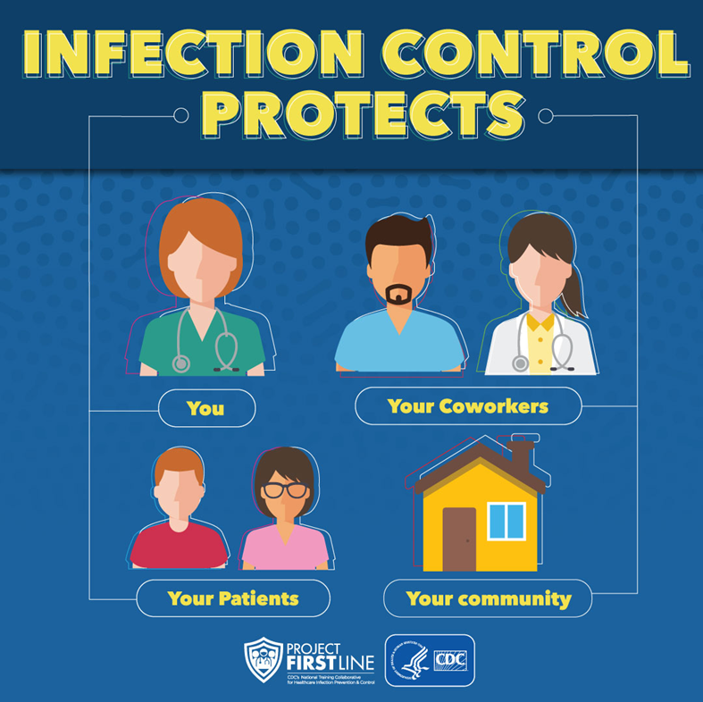
Objectives:
Describe current trends in seasonal infectious diseases
Utilize Project Firstline educational tools for infection prevention
Use cases to highlight infection prevention principles and techniques

Slide 4
Presenters
Elizabeth Butler, MD – Pediatrician, Ocean State Pediatrics
Maria Gomes, BSN, RN, CIC – Lead Infection Preventionist, Lifespan
Michael Koster, MD – Pediatric Infectious Diseases, Hasbro Hospital

Slide 5
Infection Prevention & Control
Works- the right practices stop germs from spreading
Team Effort- most effective when all team members use it consistently
Matters – critical part of safe health care delivery
Notes:
No longer something only in the hospital. The goal of Project Firstline, a partnership with CDC and for our group with the AAP.
How do we bring infection prevention and control more explicitly to the community

Slide 6
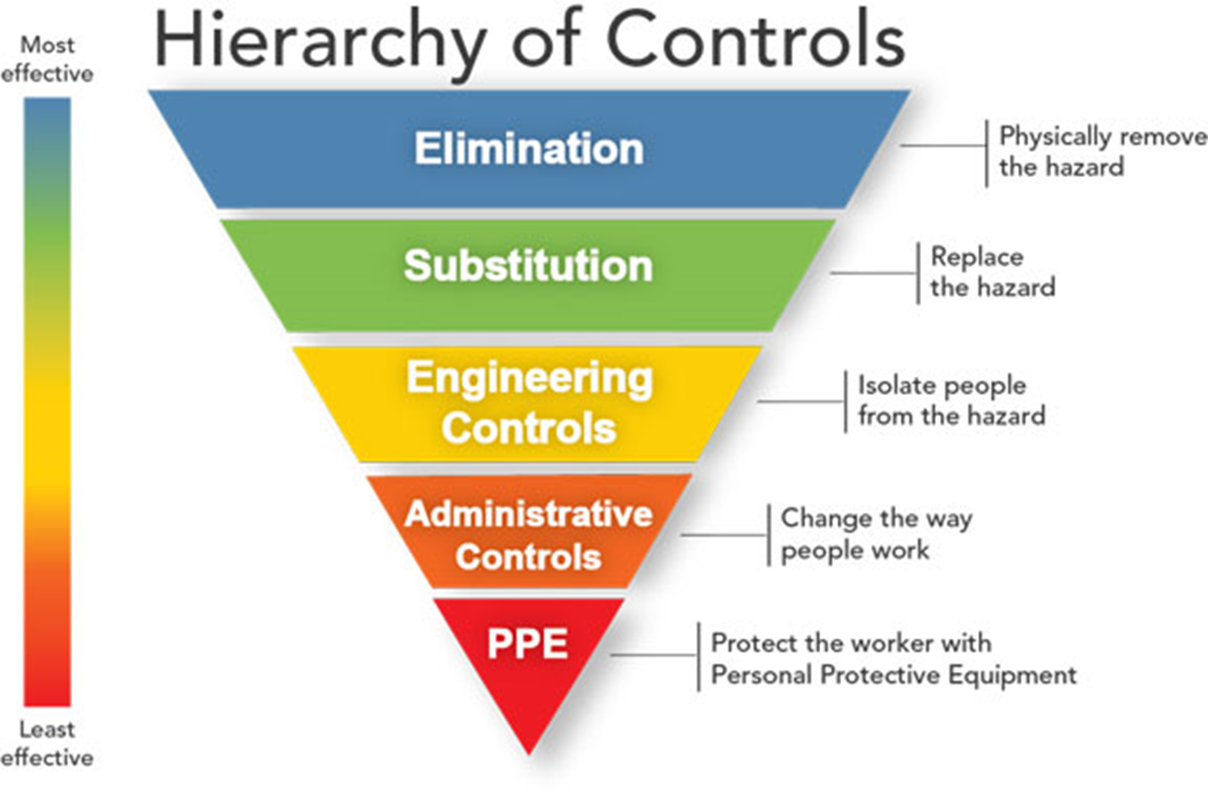
More than PPE—: retractable safety syringes, antimicrobial recommendations, disinfectants, UV light “no touch”, negative pressure rooms, HEPA filters, etc.

Slide 7
Seasonality?

Slide 8
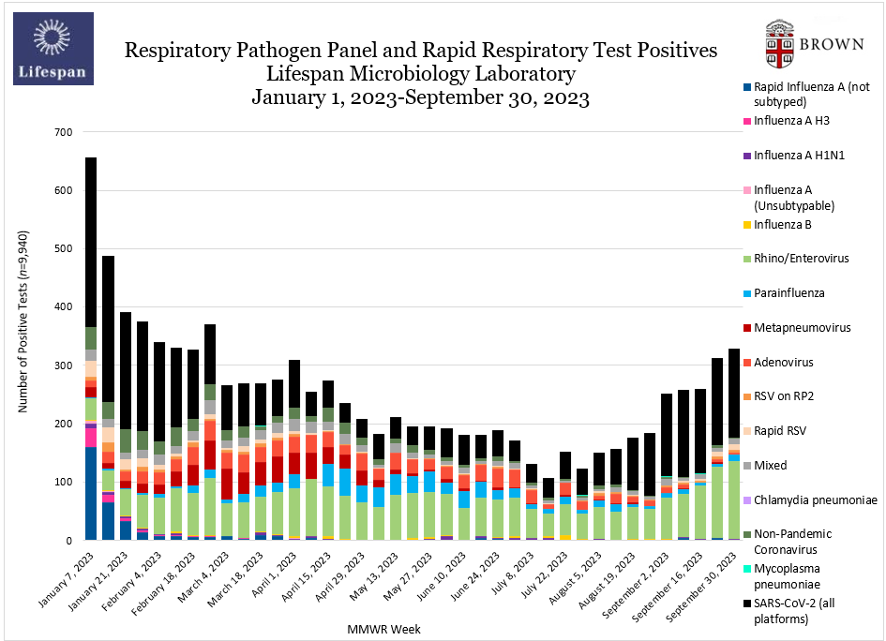

Slide 9
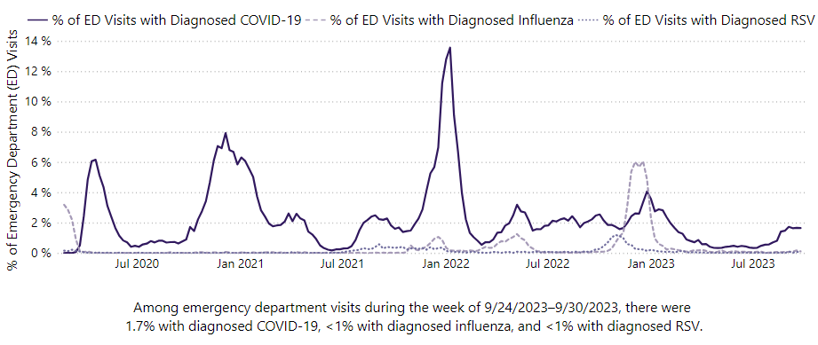

Slide 10
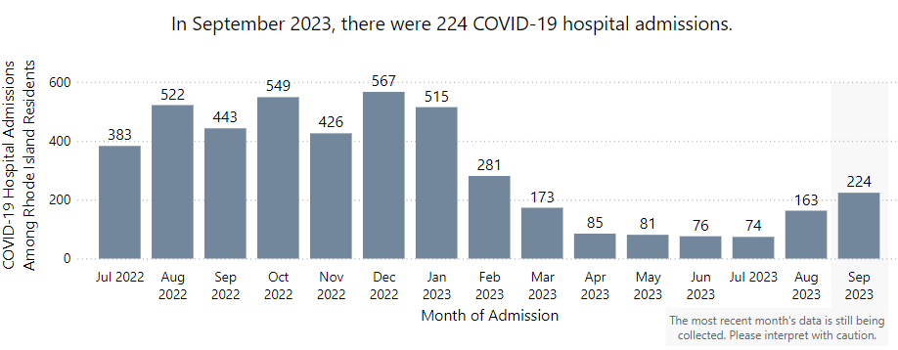
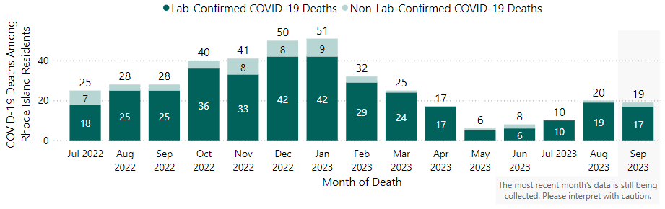

Slide 11
Pediatric Fatalities from COVID
How much, and who?

Slide 12
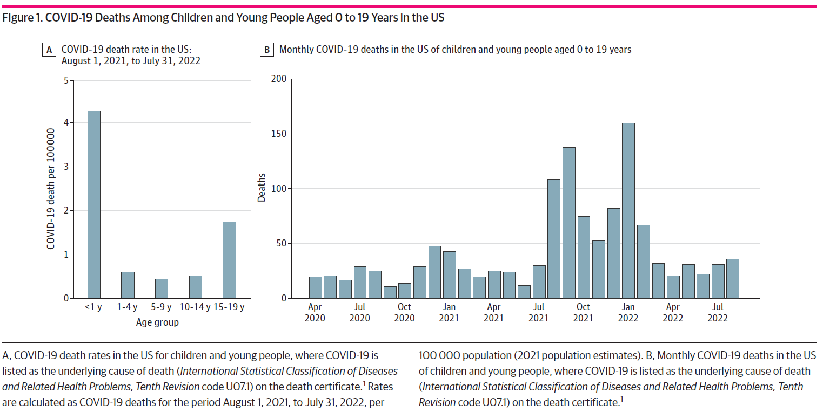

Slide 13
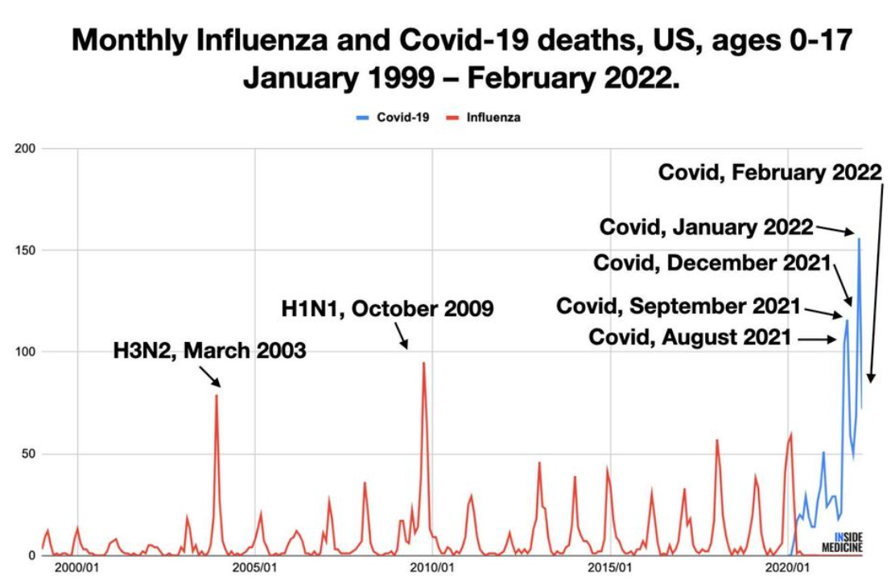

Slide 14
ACIP slidedeck 9.12.23

Slide 15
Seasonality/prevalence- how do we prepare?
Respiratory stations – sanitizer, masks at entrance/lobby
Posters – informational, infographic
Triage process – call from the car?
Stickers on ground, one way traffic
Hepa filters, increased ventilation, especially for school nurse office
Visitor restrictions
Telehealth visits
Vaccination
Risk assessments…
Notes:
Traditionally if you had an infection return to school is 24hrs fever free, 24hrs diarrhea free, etc.
2009 h1N1 changed this a bit it was those things or 7 days which ever is longer – that’s such a classic ID statement whomever made it.

Slide 16
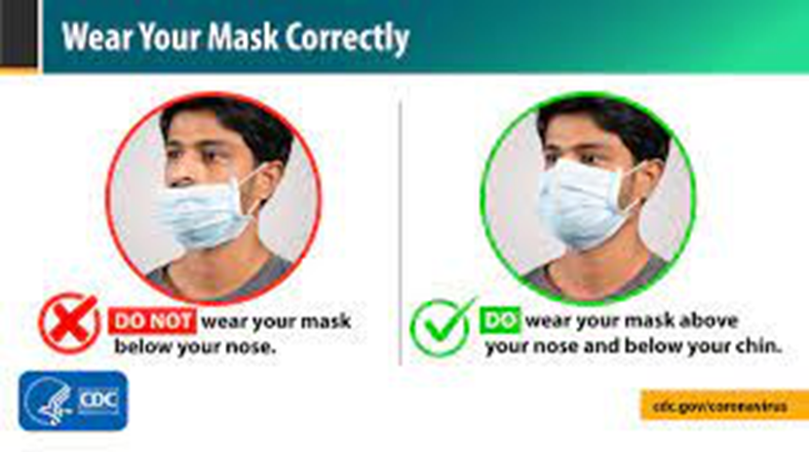
Tools for Mitigating Risk
Vaccines
Masks
Distancing
Avoid crowds/poorly ventilated areas
Hand hygiene
Therapeutics-treatments

Slide 17
Source Control
Masking anyone with symptoms is crucial
During a respiratory viral pandemic
During a respiratory viral season
This is SOURCE CONTROL
The most fundamental aspect to prevention is to stop the spread of respiratory droplets
Secondary benefit, it can also be a form of protective equipment

Slide 18
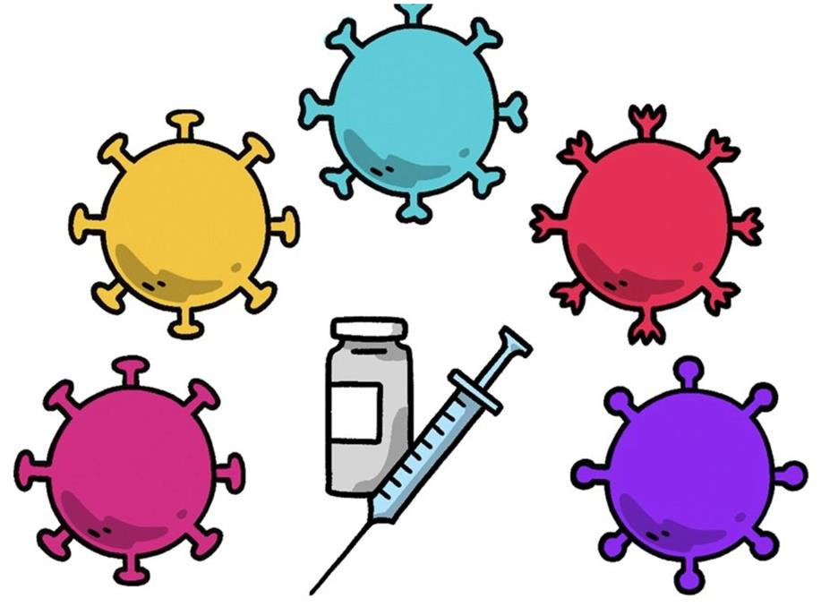
VARIANTS/STRAINS – 5 MAJOR CONCERNS
Transmissibility
Severity of illness
Immune escape
Effectiveness of therapeutics
Diagnostics
How easily the virus spreads to others
Number of hospital admissions & deaths
Will vaccines and/or prior infection protect us?
Will
antivirals work?
Will PCR and rapid antigen tests detect the variants

Slide 19
Vaccines are one of the most important Infection Prevention Tools
COVID, RSV, INFLUENZA

Slide 20
COVID Vaccine
Based on the XBB1.5 Omicron strain
Does protect against circulating strains: BA.2.86, EG.5.1, FL.1.5.1
½ of COVID deaths were healthy children
COVID is the leading infectious diseases killer of kids
Highly recommend vaccination for healthy kids as well

Slide 21
2 doses
Novavax
>12 yo
1 dose
Novavax
>12 yo

Slide 22
RSV Monoclonal - Nersivimab
Approved July 2023
Three clinical trials: close to 3,000 infants
70-80% effective in reducing medically attended RSV infections
Single shot, effective for 6 months
Co-administration with other vaccines is safe
does not interfere with immune responses
Nirsevimab Administration (aap.org)
Notes:
Pregnant women vaccinated 34-38wks (around time of GBS screening) and vaccinated at least 2 wks before delivery

Slide 23
RSV Monoclonal - Nersivimab
Infants <8mos entering 1st RSV season
At risk 8-9mos entering second season
Infants whose mothers did not receive RSV vaccine during pregnancy
Nirsevimab Administration (aap.org)
Notes:
Pregnant women vaccinated 32-36wks (around time of GBS screening) and vaccinated at least 2 wks before delivery

Slide 24
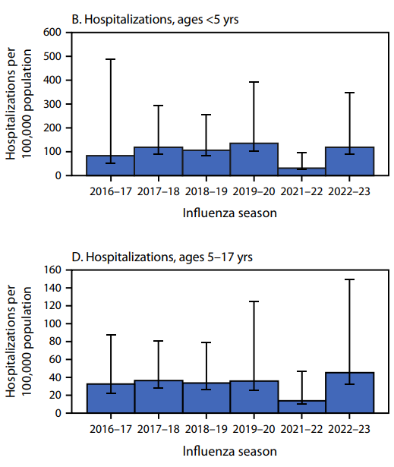
Influenza Vaccine
No longer need to worry about egg allergy
Likely to become trivalent vs quadrivalent vaccine (2A1B)
It is never too late to get the flu shot
Notes:
Egg-based, cell culture, recombinant HA
Out with Yamagata B lineage, keeping Victoria B lineage (haven’t seen Yamagata in 3 yrs)
68% effective, majority of hosp in unvaccinated kids

Slide 25
Vaccine Hesitancy
#1 make all vaccines routine
Listen
Do not judge
Offer compassion
Reflect their concerns
Validate their concerns
Provide only relevant information
Practice makes perfect
Notes:
Its not just the office, so many of us as HC professionals are approached by our family, friends, and neighbors about what should I do….

Slide 26
Cases to highlight Infection Prevention Issues

Slide 27
Rash Case Study
4-year-old healthy male presents with 3-day history of itchy rash on body, face, extremities that is spreading, not painful. He is “grumpy” but feeding and acting okay. No fever, vomiting, diarrhea. On exam, patient is well appearing, T= 98.9, no oral lesions and rash that is in various stages of healing, erythematous papules on face, chest, back, extremities, one lesion is crusted and several appear vesicular.
Fam hx: grandparent with shingles a few weeks ago.
What is your next step?
Notes:
What is your next step if you heard this story over triage or patient presented to your office or school?

Slide 28
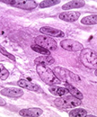
Rash Case Study
PCR swab of lesion sent to evaluate for varicella zoster
This came back positive the next day
The family and the RI DOH was alerted
Isolation protocol was put in place
Varicella is highly contagious, spread by direct contact, inhalation of aerosols from vesicular fluid of skin lesions
Contagion period: 1-2 days before rash onset until all lesions have crusted
10-21 days after exposure to develop varicella
Notes:
It takes from 10 to 21 days after exposure to the virus for someone to develop varicella. Based on studies of transmission among household members, about 90% of susceptible close contacts will get varicella after exposure to a person with disease.

Slide 29
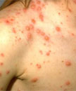
Chicken Pox (Varicella) Case Study
ICAR – Infection Control Assessment and Response
Standard precautions plus airborne precautions (negative air-flow room) and contact precautions
Keep patient isolated in closed room,
cared by for staff with evidence of immunity
Quarantine until all lesions have crusted over
Notes:
What does rash look like
What are other symptoms
What is duration of symptoms
What is treatment
How do we prevent transmission
How long is contagious
How would we deal with in office / school nursing setting
Healthcare providers should follow standard precautions plus airborne precautions (negative air-flow rooms) and contact precautions until lesions are dry and crusted. If negative air-flow rooms are not available, patients with varicella should be isolated in closed rooms with no contact with people without evidence of immunity. Patients with varicella should be cared for by staff with evidence of immunity.

Slide 30
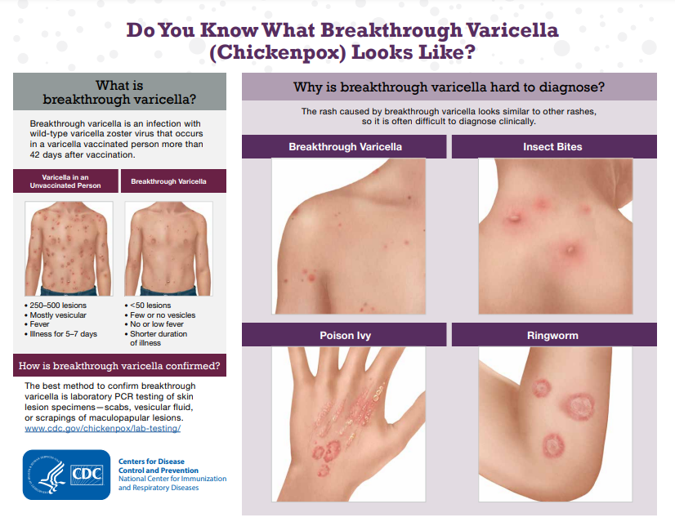
Identify and isolate cases:
In 2018 there were 67 cases of varicella reported in RI... Most cases were in children 0-4 years old. Of cases in children old enough to receive vaccine, over 90% of cases occurred in children who are up to date on vaccine
Define a case
Multiple diagnostic tests available; PCR from scabs/ vesicles preferred method
Find the cases... Wild vs. Breakthrough cases differ in presentation
Notes:
in temperate climates, follows marked seasonal pattern (late winter + early spring) and is a disease of childhood,
We may care for a number of patients from other countries, so it is important to know that that disease occurs in later ages and does not follow the same seasonal pattern that we often see here
With higher rates of vaccination, proportionally, more chickenpox cases will be the breakthrough type which can be difficult to identify

Slide 31
RIDOH Chickenpox info for Schools
Notes:
https://health.ri.gov/publications/guidelines/PreventionAndControlOfVaricellaOutbreaksInDayCarePreschoolsSchoolsCollegesAndUniversities.pdf

Slide 32
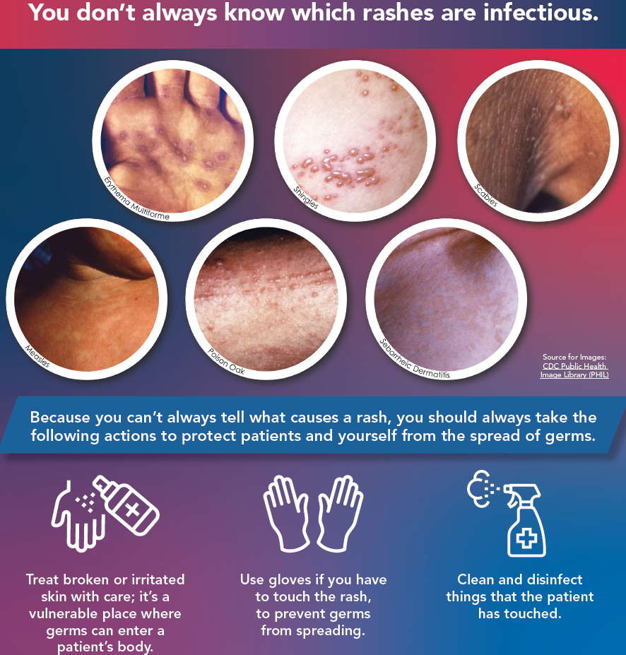
Micro-Learn on Rashes:
Easy to use and to educate frontline staff
Helpful for training for your front office staff, those who may not be clinical

Slide 33
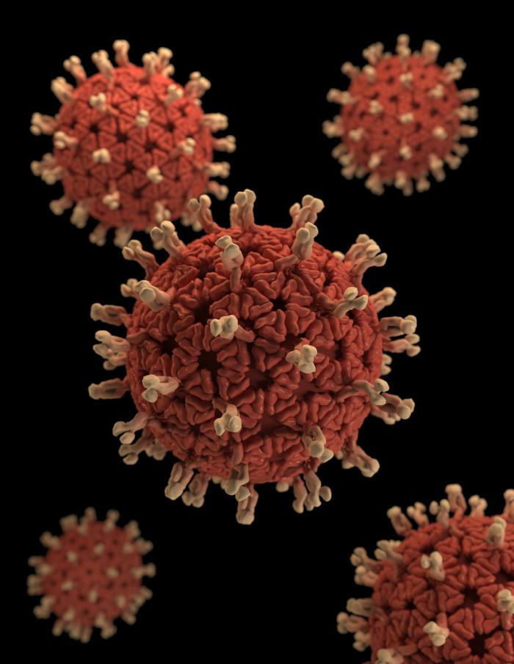
Diarrhea Case Study
10-month-old female presents with 2 days of fever, diarrhea, decreased oral intake and decreased voiding (1 void in past 24 hours).
On exam T=102, HR= 160, she is tired, pale on exam with hyperactive bowel sounds, sunken fontanelle and dry mucous membranes.
She is admitted to the hospital for IV hydration, further evaluation and monitoring. Stool study is sent and is found to be positive for rotavirus.

Slide 34
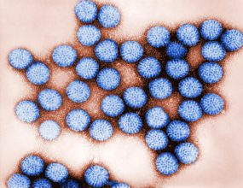
Rotavirus
Data tracking / Current Trends : The National Respiratory and Enteric Virus Surveillance System (NREVSS)
https://www.cdc.gov/surveillance/nrevss/index.html
Transmission: Fecal- oral
Prevention: Handwashing, vaccination
How long contagious: shed in stool, contagious when symptomatic , 3 days after recovery
How to manage in school setting: hand hygiene, proper disposal of diapers, when to return to daycare

Slide 35
Office visit suggestions for infectious diseases
Consider telehealth
Last visit of the day
Alternate entrance
Child/family mask
Staff mask +PPE
Clean room with bleach after
Monitor team for symptoms

Slide 36
Key Takeaways:
Micro-learns on PFL website: 4 topic areas
BLOOD RASHES COUGH WOUNDS

Slide 37
Case Scenario
A teacher sends his student to the nurse’s
office because she has been scratching her
head for several days, appears tired and is
having difficulty focusing.
Notes:
Some of you may already be scratching your heads by now. Rest assured you won’t get head lice from participating in this webinar.
Lice are spread through head to contact during common play at home, school, sports activities, playgrounds, camps, sleepovers, etc…
Scientific name is Pediculus humanus capitis aka Lice
As Ellie mentioned assessment starts with Identifying what is in front of us. So if you think this sounds like lice, you’ll need to check the students hair to make sure it is fact in lice.
Show of hands how many of you have ever seen lice? If you haven’t today’s your lucky day.

Slide 38
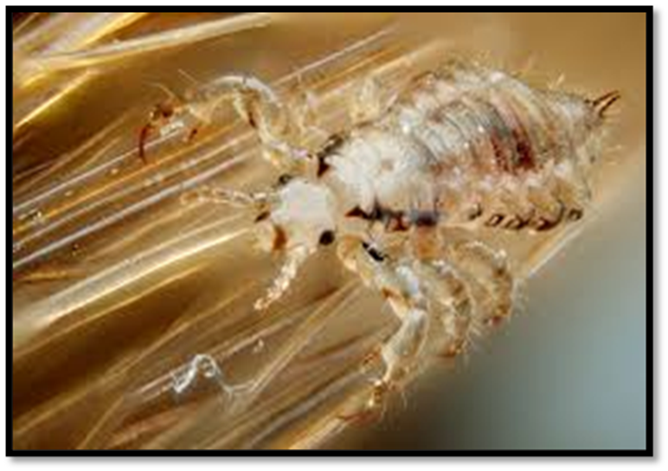
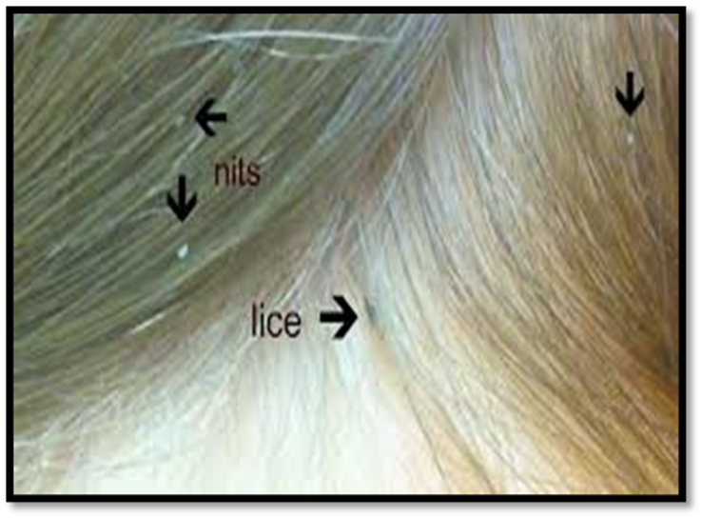
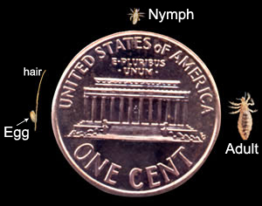
Adult Louse Nits 3 Life Forms
Notes:
Identify, Isolate & Inform
Based on the scenario I’m we’ve all assumed this child has lice. However, we need to identify that there are actual lice.
Pic #1. Not actual size.
Pic # 2 Nits are eggs that the louse lay, They are white and attach to the hair strand with a glue-like substance. Dandruff is often mistaken for nits. Tip: If its not shaking its still baking!
Pic # 3 Actual size of 3 lice forms compared to a penny.
Audience participation

Slide 39
Symptoms
Itching – caused by reaction to the louse bites
Tickling feeling
Irritability and difficulty sleeping
Sores caused by scratching
Notes:
Sores can sometimes become infected with bacteria normally found on a person’s skin.

Slide 40
The Facts of Lice
Kids with lice can’t come to school
MYTH
Lice can spread from sharing brushes, helmets or clothing
FACT
Only kids get lice
MYTH
I can get lice from being in the same room as a person with lice
MYTH
Lice can jump and fly from one head to another
MYTH
Lice spread disease
MYTH
FACT
The cleanliness of your home has nothing to do with getting lice
Notes:
1. . Having Lice is not a barrier to staying in school. Kids may remain in school until the end of the day and return after appropriate treatment. Can stigmatize the child. CDC recommends that schools do not have a no nit policy.
2. Lice can transfer onto clothing, uniforms, bedding, stuffed animals, brushes, hats, helmets, blankets. Not common but possible. Lice only live off the human head for a a day or so. Nits won’t hatch at temperatures lower than the human scalp.
3. Lice do not discriminate. Anyone can get lice in their hair, beard and sometimes in eyebrows and eyelashes
4. Lice is spread from close to close (head-to-head ) contact or by sharing items that have come into contact with an affected person’s head.
5. Lice do not jump or fly. They do not have wings. They crawl along the hair shaft. They are typically found close to the scalp, behind the ears and nape of the neck.
6. Lice are not known to spread or transmit disease. Pruritis or itching is caused by an allergic reaction to louse bites. It may take 4–6 weeks for itching to appear the first time a person has head lice.
7. The cleanliness of your home has nothing to do with getting lice. When it comes to the classroom, daily cleaning will suffice. Drastic cleaning & disinfection measures are not required.
Wish I could see you all because this next slide usually evoke a certain response from the audience.

Slide 41
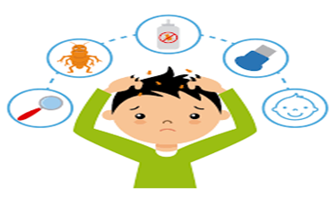
Lice Assessment, Treatment & Prevention
Assessment
Wear gloves while sifting through the hair.
Use a magnifying glass to visualize the lice and nits.
Dandruff may be confused for nits. Lightly shake the hair.
Treatment
Both over-the-counter and prescription products are available.
The key to getting rid of lice is effective comb outs.
Prevention Tips
Keep hair tied back when assessing for lice and nits.
Have the child sit on an unupholstered chair during lice check.
Consider exclusion from sports activities that require close contact while live lice are present.
Notes:
Identify, Isolate & Inform (educate families)- refer to picture
Assessment -
Treatment- Shampoo only kills lice. Use vinegar for nits.
Prevention
1. Wrestling for example. Overnight trips???

Slide 42
Family Education
CDC Examination Guide-English and Spanish
Thorough comb outs to remove nits
Avoid hair washing for up to 2 days after treatment
Examine others in the home
Avoid sharing bedding, head wear and other items that come into contact with the head

Slide 43
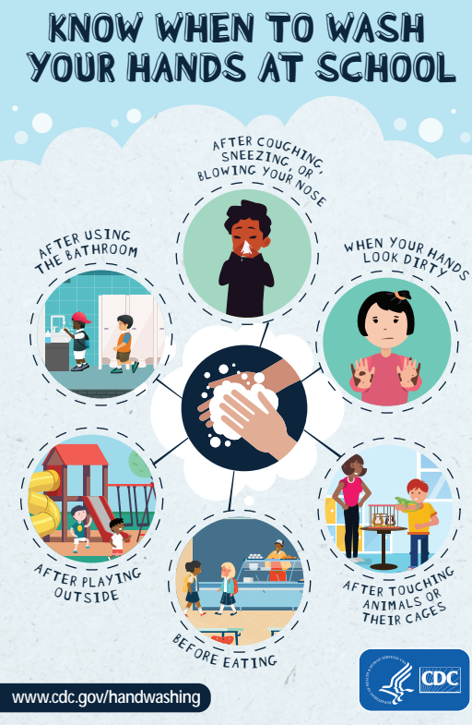
Hand Hygiene Education
Get kids excited about hand hygiene
Make it fun- games, create slogans, songs
Visible cues- posters with instructions
Set the Example
Notes:
How many times do you clean your hands during a typical workday? More than 10? More than 20? Show of hands.
Do you increase hand hygiene during respiratory season? Is it activity based?
Discuss Soap and Water vs Alcohol Based Hand Rub
Games- bowl of water with pepper (germs) add soap. Germs disappear.
Posters- classrooms, restrooms, nurses office
Example-

Slide 44
Key Takeaways
Lice is not a barrier to staying in school
Use hats or hair ties (staff &child)
Use a magnifying glass
Drastic cleaning measures are not required
Assess restriction from sports or other close contact activities
Provide education for families
Hand hygiene is the best defense against spreading germs and illness
Know & Use Your Resources

Slide 45
Final Takeaways:
Good news we have vaccines for the three most common respiratory illnesses causing hospitalizations
Mirco-Learns are great educational resources for offices and school settings
Planning is key for managing infectious diseases in clinic and schools

Slide 46
Resources:
ACIP slidedeck 9.12.23
Nirsevimab AAP
Project Firstline Micro-learns
CDC Head Lice
CDC Head Lice School
Handwashing | CDC

Slide 47
Evaluation Links
CME EVALUATION LINK
AAP PFL EVALUATION LINK

