Slide 1
Respiratory-Related Illnesses: Part 2
Date and/or Faculty

Slide 2
Acknowledgements
Project Firstline is a national collaborative led by the US Centers for Disease Control and Prevention (CDC) to provide infection control training and education to frontline healthcare workers and public health personnel. AAP is proud to partner with Project Firstline, as supported through Cooperative Agreement CDC-RFA-OT18-1802. CDC is an agency within the Department of Health and Human Services (HHS). The contents of this program do not necessarily represent the policies of AAP, CDC or HHS and should not be considered an endorsement by the Federal Government.

Slide 3
This ECHO curriculum was adapted by the 2024 National AAP Infection Prevention and Control School-based Health ECHO
Acknowledgements

Slide 4
Housekeeping
Please do not provide any protected health information (PHI) during any xxx.
IT trouble? Chat to xxx
Please turn on your video!
Please enter your name and organization in the chat box.
Please mute your microphone when not speaking.
Introduction
Lecture
Case/Discussion
Close
Introduce Yourself
Microphones
Agenda

Slide 5
Video Recording
The lecture portion of this session will be recorded for educational and quality improvement purposes.
Notes:
This session will be recorded for educational and quality improvement purposes. By participating in the call today, you are consenting to this recording. Slides from today’s call, along with a video recording of the lecture, will be shared following this call. However, a recording of the case discussion will not be shared; this is to ensure confidentiality and provide a safe space to discuss concerns and questions.
START RECORDING

Slide 6
Group Norms
Confidentiality
All ideas and questions are valued
Mutual respect
Celebrate differences
Contribute to a safe and supportive environment
Let others complete their thoughts
Active listening
No hierarchy
Empathy
No jargon, define abbreviations, and use common language
Why Am/Aren’t I Participating?

Slide 7
Faculty Team
Faculty Member Name
Practice/Location
Faculty Member Name
Practice/Location

Slide 8
Speaker Name
Title
Insert Photo

Slide 9
Disclosures
I have no relevant financial relationships with the manufacturer(s) of any commercial product(s) and/or provider of commercial services discussed in this CME activity.
I do not intend to discuss an unapproved/investigative use of a commercial product/device in our presentation.

Slide 10
Objectives
Understand how infections spread and key prevention strategies to reduce the risk of spread.
Recognize disease-specific signs and symptoms, incubation and contagious periods, transmission, infection control guidance, and school exclusion and readmittance criteria for 4 respiratory-related illnesses.

Slide 11
Infectious Diseases of the Day!
Infectious Disease | Description
Strep Throat (Streptococcal Pharyngitis) | A disease caused by group A Streptococcus bacteria
Mono (Mononucleosis) | A disease most commonly caused by Epstein-Barr virus (also called EBV or human herpesvirus 4) and sometimes by other viruses such as cytomegalovirus (human herpesvirus 5) and roseola (human herpesvirus 6)
Whooping Cough (Pertussis) | An acute infectious disease caused by the bacterium Bordetella pertussis that starts with a cough and typically leads to weeks of coughing even after successful treatment
Pink Eye (Conjunctivitis) | Inflammation (ie, redness, swelling) of the thin tissue covering the white part of the eye and the inside of the eyelids

Slide 12
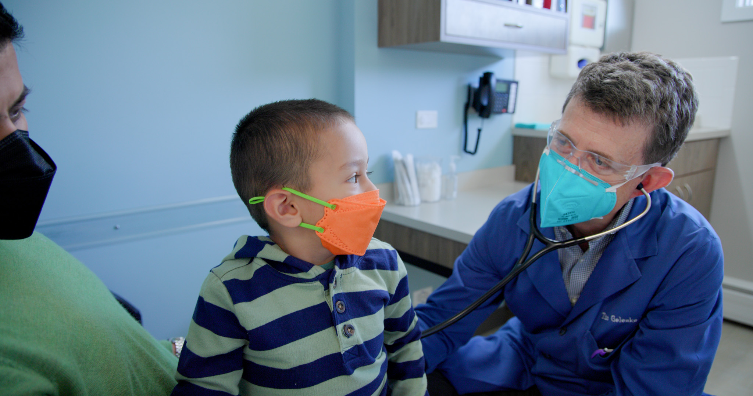
Signs and Symptoms: Strep Throat
Strep Throat:
Fever
Sore throat
Stomachache
Vomiting
Headache
Swollen lymph nodes in the neck

Slide 13
Signs and Symptoms: Mono
Mono:
Prolonged fever
Prolonged sore throat
Swollen lymph nodes
Fatigue
Enlarged spleen or liver
Rash may occur with those treated with amoxicillin or other penicillin

Slide 14
Signs and Symptoms: Pertussis
Whooping Cough:
Catarrhal: Days 1-7
Coryza (runny nose),
Low grade fever
Mild cough
Paroxysmal: Days 7-30 (up to 10 weeks)
Forceful coughing episodes
Often with a characteristic high-pitched whoop
May be accompanied by vomiting and chest pain
Typically afebrile
Convalescent
Gradual recovery, lessening of coughing spells
Vaccinated individuals may have milder disease, but can transmit to susceptible persons

Slide 15
Incubation and Contagious Period
 | Strep Throat | Mono | Whooping Cough
Incubation Period | 2 – 5 days | “Mono syndrome” Incubation periods vary by etiologic virus. For the two major viruses: 30-50 days (EBV) 1-3 months (CMV) | 7 – 10 days with a range of 5 – 21 days
Contagious Period | Risk of spread is reduced when a person who is ill with strep throat is treated with antibiotics 12-hours following appropriate treatment (AAP Red Book) Up to 25% of asymptomatic school-children and a small number of adults carry the bacteria that cause strep throat in their nose and throat are not ill In outbreaks, a higher proportion of children with no symptoms of illness may be carriers. The risk of transmission from someone who is not sick but is carrying bacteria is low | Virus is present in respiratory secretions for several weeks after symptom onset but typically only spread thru close sharing of oral secretions (sharing utensil or kissing) | 5 days of appropriate antibiotics OR 21 days after onset of cough, if not treated

Slide 16
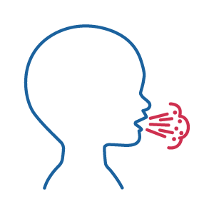
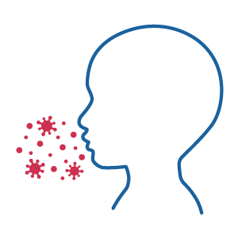
Spread of Infection
Respiratory (Droplet) Route:
Contact with large droplets that form when a person talks, coughs, sneezes, or sings
These droplets can land on or be rubbed into the mucous membranes of the eyes, nose, or mouth
The droplets do not stay in the air; they usually travel no more than 3 feet before they fall onto the ground
Airborne Route:
Breathing small particles containing viruses floating in the air
These particles can sometimes be generated when a person coughs or sneezes
These small particles contain germs and can remain suspended in the air for long periods of time
These particles can travel long distances along air currents and can infect people more than 3 feet apart in the same or even in another room (unless the doors are closed)
Contact Route:
People carrying respiratory viruses can contaminate surfaces or objects with their respiratory or oral secretions, either directly through an uncovered cough or sneeze or indirectly by touching an object with unclean hands
Other people can become infected after touching these contaminated surfaces or objects and putting fingers in their own mouths, eyes, or nose

Slide 17
How do they Spread?
 | Transmission Route
Strep Throat
Mono | Person-to-person contact Kissing Sharing objects contaminated with saliva (eg, toys, toothbrushes, cups, bottles) May be spread by blood transfusion or organ transplantation
Whooping Cough

Slide 18
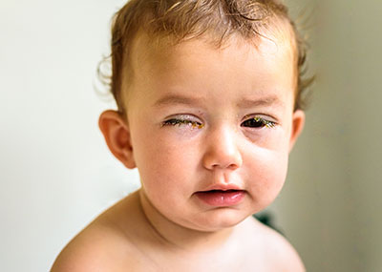
Conjunctivitis
Viral Signs and Symptoms
Pink, swollen, watering eye (s) sensitive to light
May affect only 1 eye or both eyes
Bacterial Signs and Symptoms
Red or pink, itchy, painful eye (s)
More than a tiny amount of green or yellow discharge
Infected eyes may be crusted shut in the morning
May affect 1 or both eyes
Spread: Hands become contaminated by direct contact with discharge from an infected eye or by touching other surfaces that have been contaminated
Controlling the Spread
Clean hands before and after touching the eyes, nose, and mouth
Avoid touching face
Consult a health professional for diagnosis and possible treatment of conjunctivitis. The role of antibiotics in preventing spread of bacterial conjunctivitis is unclear
Antibiotics shorten the course of pinkeye only minimally, if at all
Most children get better after 5-6 days without antibiotics

Slide 19
School Exclusion & Readmittance
Respiratory Illness | Exclusion Criteria | Readmittance Criteria
Strep Throat | Exclude from school if child has positive strep test or throat culture | Fever free for 24 hours without fever reducing medication At least the first 12 hours of antibiotic treatment has been given
Mono | Exclusion not recommended | School-aged children should avoid contact sports if they have an enlarged spleen until the spleen is no longer enlarged
Whooping Cough | Cases must be excluded from school until appropriate treatment provided | 5 days of appropriate antibiotic treatment is completed OR 21 days after cough onset if no treatment is received
Pink Eye | Exclusion is not recommended It is important for children with pink eye to be diligent with washing hands until symptoms have resolved | Antibiotics are not required for school return
Notes:
School nurses should recommend children see their primary care provider for diagnosis and treatment.

Slide 20
Controlling the Spread | Whooping Cough
Whooping cough is a vaccine preventable disease; however, protection is incomplete and decreases over time.
Follow the most recent immunization schedule for children and adults.
Review immunization status of all children, remain aware that children with incomplete vaccination may be vulnerable.
Remind staff to discuss their immunization status with their primary care providers.
Refer staff that develop respiratory symptoms to their primary care providers for evaluation.

Slide 21
Whooping Cough | Role of School Nurses and Local Health Department
Children with confirmed whooping cough may be excluded from school until 5 days of antibiotic treatment has been received.
The local health department can inform schools if whooping cough is circulating in the community.
The local health department may contact the school nurse if children or staff with exposure to confirmed whooping cough need preventive treatment (ie, prophylaxis).
During outbreaks of whooping cough, the local health department may provide measures to protect the health of children that may be unvaccinated for a variety of reasons.
The local health department can provide information about immunization and prophylaxis recommendations for adult staff members. The school nurse may direct staff to their primary care providers if they develop coryza or paroxysmal cough.
Report the Infection to the Local Health Department
If the health professional who makes the diagnosis does not inform the local health department that the infected child is a participant at school, this could delay controlling the spread

Slide 22
Partnering with your Local Health Department
Schools are required to report the occurrence or suspected occurrence of specific diseases to their local health department (LHD).
Reporting to the LHD allows them to:
Identify disease trends, outbreaks, and epidemics.
Enable preventative treatment and/or education.
Target prevention programs, identify care needs, and allocate resources efficiently.
Inform epidemiological practice and research.
Evaluate the success of long-term control efforts.
Assist with local, state, national, and international disease surveillance efforts.

Slide 23
Closing
It is important to take the proper precautions to prevent the spread of respiratory-related illnesses amongst school staff and students, specifically cleaning hands, respiratory etiquette, cleaning and disinfecting, and updated immunizations.
Ensure there is protocol in place for school staff to report diseases to the local health department.

Slide 24
AAP Resources
American Academy of Pediatrics
Project Firstline
AAP Red Book
Cleaning and Disinfecting Resources
Hand Hygiene Quiz
Managing Infectious Diseases in Schools
Immunization Campaign Toolkit
Communicating with Families and Promoting Vaccine Confidence

Slide 25
Resources
Centers for Disease Control and Prevention
Child and Adolescent Immunization Schedule by Age
Operational Guidance for K-12 Schools and Early Care and Education Programs to Support Safe In-Person Learning
Strep Throat: All You Need to Know
Whooping Cough (Pertussis)
Project Firstline
National Resource Center for Health and Safety in Child Care and Early Education
Caring for our Children: National Health and Safety Performance Standards; Guidelines for Early Care and Education Programs Standard 5.2.1.2

Slide 26
Resources for Families | HealthyChildren.org
Immunizations
Disease Prevention
Cleaners, Sanitizers & Disinfectants
Germ Prevention Strategies
Hand Washing: A Powerful Antidote to Illness
Oral Health
Reducing the Spread of Illness in Child Care
Conditions
Strep Throat
Mono
Pertussis
Pink Eye

Slide 27
Case Presentation & Discussion

Slide 28
Case
Pre-k – 5th grade school
The county is split between Rural and Suburban. This school is in a suburban setting.
881 students, approximately 100 staff
School has written policy for communicable diseases specifically, such as TB, and blood borne pathogens. Our policy for other illnesses simply states we will follow public health law for reportable diseases
Kindergarten students presenting to the school nurse with redness of conjunctiva, and some students with drainage
The school nurse had also received calls and documentation from families of other students affected, in addition to the students seen in the nursing office
From Jan 23- Feb 10, one classroom had 13/21 students affected. One parent reported their child having to be treated 3 times. This parent did provide documentation of bacterial conjunctivitis from the child’s provider
Our school policy is not to exclude from school unless the child is so uncomfortable that they cannot learn. We recommend evaluation by a healthcare provider

Slide 29
Case
A letter was sent home to the families in this classroom to alert them to signs and symptoms of conjunctivitis, recommend keeping child home if symptoms are present, and to seek guidance from your healthcare provider
We had a few parents upset and questioning our (lack) of policy and procedures. They did not want children with symptoms allowed at school, specifically
We brought the case to our local health department communicable disease nurse, we also presented our case and research to our School Health Advisory Council. Both instances confirmed our procedure aligns with most published information on best practices for conjunctivitis
We asked the classroom teacher to have the students wash their hands throughout the day, and the classroom surfaces were regularly cleaned

Slide 30
Case Discussion
Is there anything else we should have done in this scenario?
Should policy/procedure change given the number of students affected?
How and what would you communicate to the parents?

Slide 31
Thank you!

